Slide 1


OceanSITES in the context of NOAA’s Climate Observation Division Data Management Assessment
Prepared by:
Jennifer Saleem Arrigo, Program Manager
NOAA/OAR/Climate Program Office
Climate Monitoring Program
Jennifer.saleemarrigo@noaa.gov

Slide 2
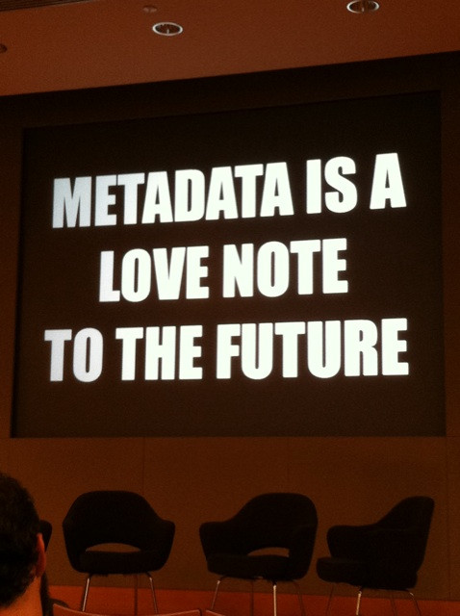

Slide 3



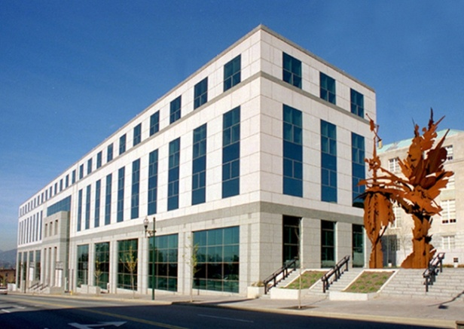
Vision for NOAA Data Management
All NOAA environmental data shall be
Discoverable
Accessible
Usable
Preserved
for all types of users and applications.
Implementation of NOAA’s response to US PARR (Public Access of Research Results) and working toward achieving this vision

Slide 4
How is OceanSITES doing?
Is OceanSITES data
Discoverable
Accessible
Usable
Preserved
for users and applications?

Slide 5
How is OceanSITES doing?
Is OceanSITES data
Discoverable
Accessible
Usable
Preserved
for users and applications?
Data access methods or services offered: Data are collected in near-real-time from nearly all Ocean Reference Stations and immediately made available on the Global Telecommunications System (GTS); data are also made accessible at the Global Data Assembly Centers at NDBC and IFREMER via ftp. Data available from THREDDS and OpenDAP at NDBC. Limited services are available to help users retrieve datastreams.

Slide 6
What’s your vision for OceanSITES?
for some key users and applications.
Discoverable
Accessible
Usable
Preserved
WHO do you think can use the data?
WHAT makes the data unique/ valuable?
WHERE do you discover/access/use data yourself (or your students, or your colleagues)?
HOW do potential users want to get that data?
WHY are you doing this?
your KEY

Slide 8
Well on the Way
Long term effort and mature data model; decisions to use standards sets you up well
good conversations this week - identify your users and address their needs; identify your wants and what you can do to help acheive them
Build upon what’s been done - next steps should be driven by your priorities
International effort presents opportunities and challenges
Love your data? Love your metadata
Notes:
Some of the common issues that came up during my initial assessment – some new things I dealt with not having an ocean data or ocean observing background.

Slide 9
Where we are and what’s next
Initial Data Management Plans for six systems on file (soon public)
  Projects are spending between 2% and 21% of resources on data management
  Meeting metadata requirements; Getting data registered in noaa.data.gov
  Harnessing the results (better dissemination)
  Grants-generated data
  Online access formats need more standardization – build on good examples
    UAF- Unified Access Framework (TDS/CF/NetCDF)
    https://geo-ide.noaa.gov/

Slide 10
Data Management Assessment
Starting with the Six NOAA Systems of Record that contribute to GOOS
  eXpendable Bathythermograph (XBT)Network, contributions to Global Sea Level Observing System, Ocean Reference Sites – part of Global OceanSITES, Argo program, Global Carbon Networks, Global Drifter Program, (GTMBA (TAO, RAMA, PIRATA) assessed by PMEL)
Template to Assess
  Data Lineage and Quality
    Workflow and quality control
  Documentation
    The EDMC Data Documentation Procedural Directive requires that NOAA data be well documented, specifies the use of ISO 19115 and related standards for documentation of new data, and provides links to resources and tools for metadata creation and validation.
  Discovery and Access
    The EDMC Data Access Procedural Directive contains specific guidance, recommends the use of open-standard, interoperable, non-proprietary web services, provides information about resources and tools to enable data access
  Data Preservation and Protection
Notes:
Worked with program managers who are funding and thus responsible for ensuring the data stewardship and scientists/PIs who are actually implementing and maintaining the networks

Slide 11
Snapshot of OceanSITES
Metadata for Discovery
Discovery metadata allows users to search and find NOAA data holdings using text, keyword, temporal, and spatial queries, and to locate a contact person for the data they discover.
To allow for data discovery without downloading the data files themselves, an ‘index file’ is created by each of the GDACs. The index file is a comma-
separated-values text file named oceansites_index.txt, in the root directory of each GDAC. It contains a list of the files on the server, and metadata extracted from those files. The file contains a header section, lines of which start with # characters, the list of all data files available on the GDAC, and their descriptions.
VS. NCEI archived data - compliant metadata for discovery; WAF or metadata catalog; ability to list in multiple catalogs
Discoverable
Accessible
Usable
Preserved
for all types of users and applications.
7.3% of NOAA funding for OceanSITES dedicated to Data Management

Slide 12
Snapshot of OceanSITES
Data shall be available in one or more machine-readable digital formats. Open-standard, non-proprietary formats are recommended, per US Open Data Policy.14
Data access methods or services offered: Data are collected in near-real-time from nearly all Ocean Reference Stations and immediately made available on the Global Telecommunications System (GTS); data are also made accessible at the Global Data Assembly Centers at NDBC and IFREMER via ftp. Data available from THREDDS and OpenDAP at NDBC. Limited services are available to help users retrieve datastreams.
Accessible
Accessible
Usable
Preserved
for all types of users and applications.
7.3% of NOAA funding for OceanSITES dedicated to Data Management

Slide 13
Snapshot of OceanSITES
Limited services are available to help users retrieve datastreams.
Vs. Argo
“via the GTS for operational centers (data are in TESAC or BUFR format), via DOIs on the GDACs, via the two Global Data Assembly Centers (GDACs) in NetCDF format, via Data selection tools on the GDACs, via gridded fields and velocity products based on Argo NetCDF files from the GDACs, via data viewers that incorporate Argo data, via individual float data and plots at Coriolis GDAC, via the Global Argo Data Repository (GADR) for archived and offline data”
Usable
Accessible
Usable
Preserved
for all types of users and applications.
Who are your users?
What do they need? (e.g. Flux calculations, continuous time series)
How will they find and understand the data?

Slide 14
What’s your vision for OceanSITES?
for some key users and applications.
Discoverable
Accessible
Usable
Preserved
WHO do you think can use the data?
WHAT makes the data unique/ valuable?
WHERE do you discover/access/use data yourself (or your students, or your colleagues)?
HOW do potential users currently view your data?
WHY are you doing this?
your KEY

